Slide 1

Your Experts in Smart Meter Data Anomaly Detection
Energy Data Hackdays 2020 – Challenge 14
Märu Giger, Dävu Giger, Vik Bhatnagar, Ray Neubauer

Slide 2
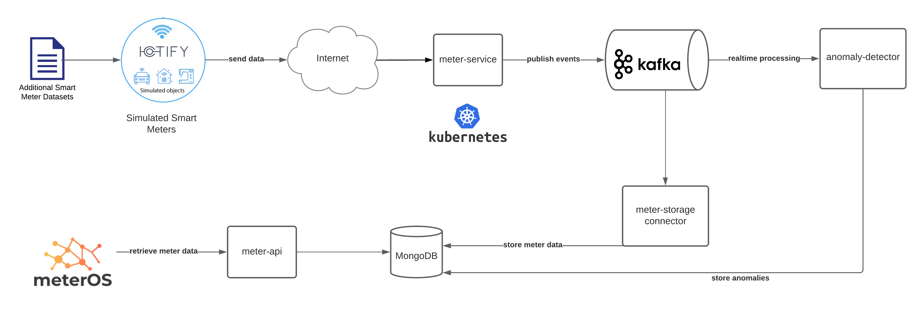
Smart Meter Data Anomaly Detection - Approach
EXPERT ANALYSIS MODEL (based on historic data)
PREDICTIVE MODEL (live data)

Slide 3
Smart Meter Data Anomaly Detection – Expert Analysis
Manual (expert) data analytics
Data structuring (weekly / daily)
FFT
Correlation
Threshold-based analysis (min/max, zeros, gradient, baseload, etc.)
GOAL: create predictive model that is “smarter” (and faster) than the manual Expert Analysis

Slide 4
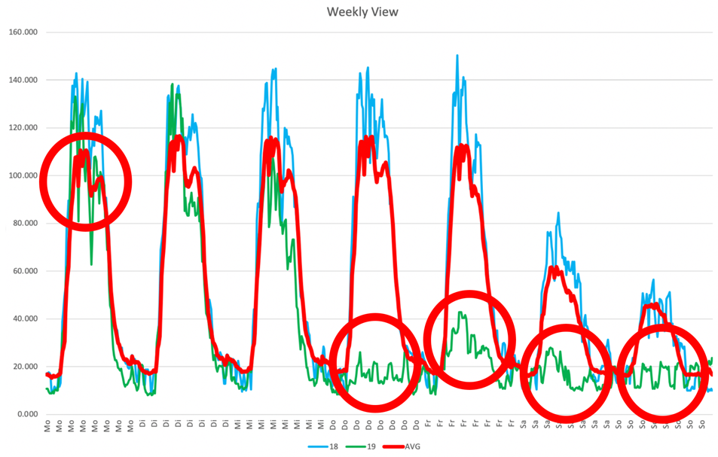
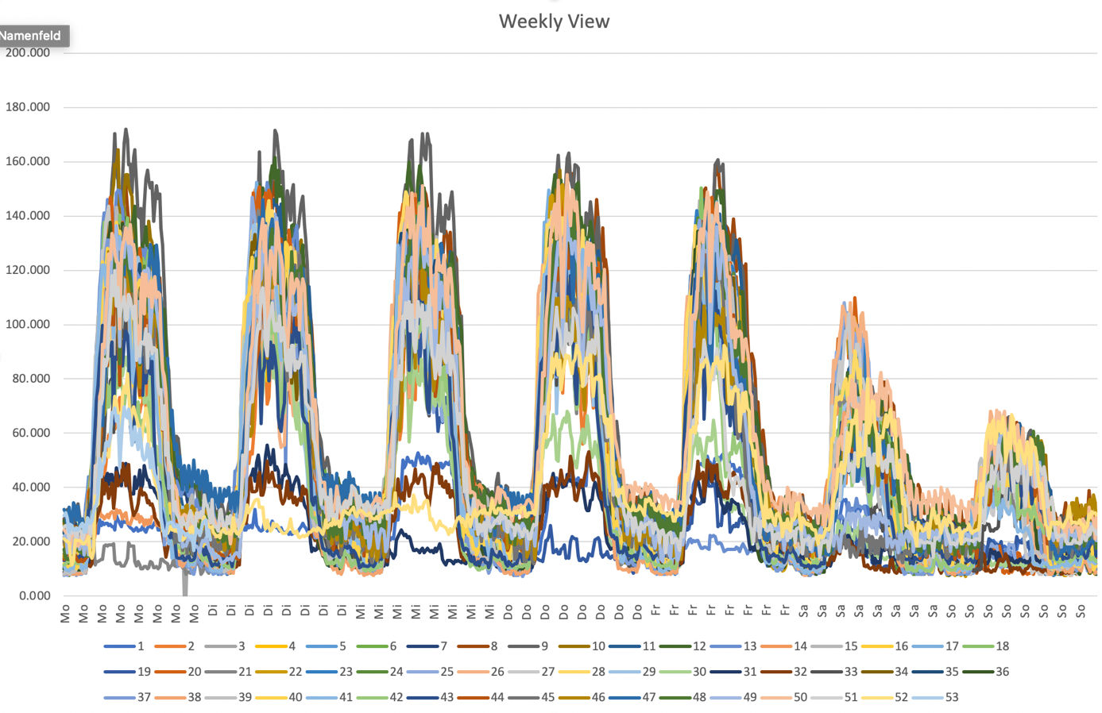
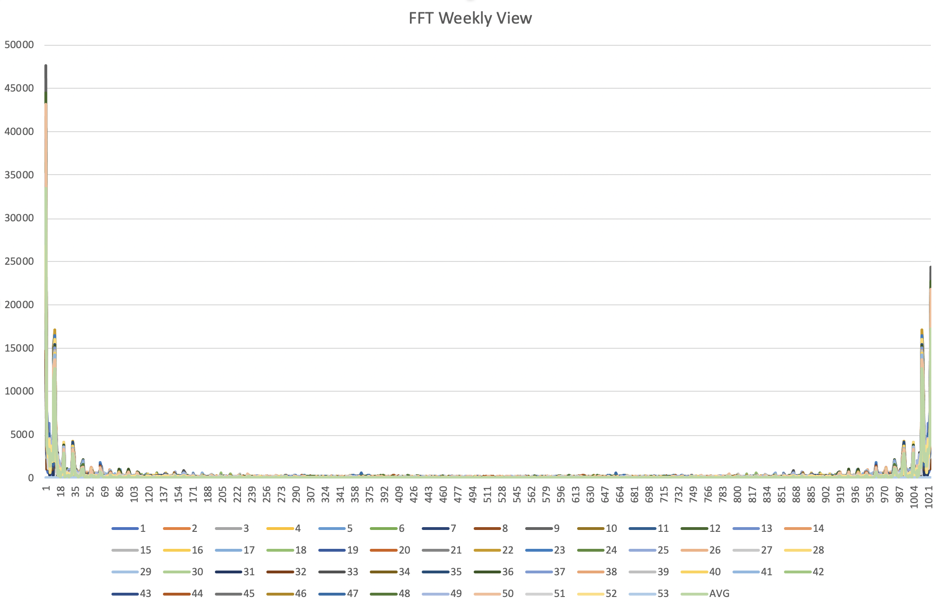
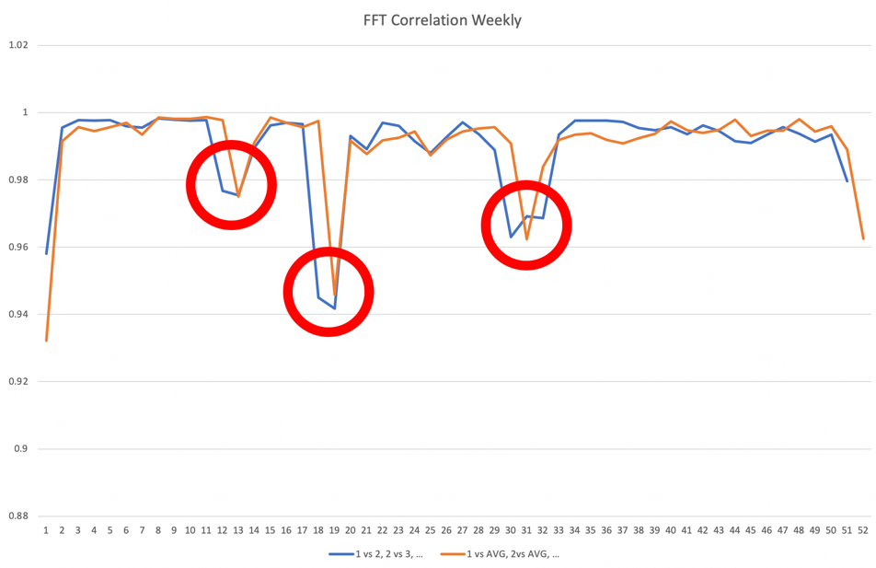
Smart Meter Data Anomaly Detection – Expert Analysis
Weekly Data Structuring
FFT Analysis
Correlation and Anomaly Detection

Slide 5
Smart Meter Data Anomaly Detection – Predictive Model

Slide 6
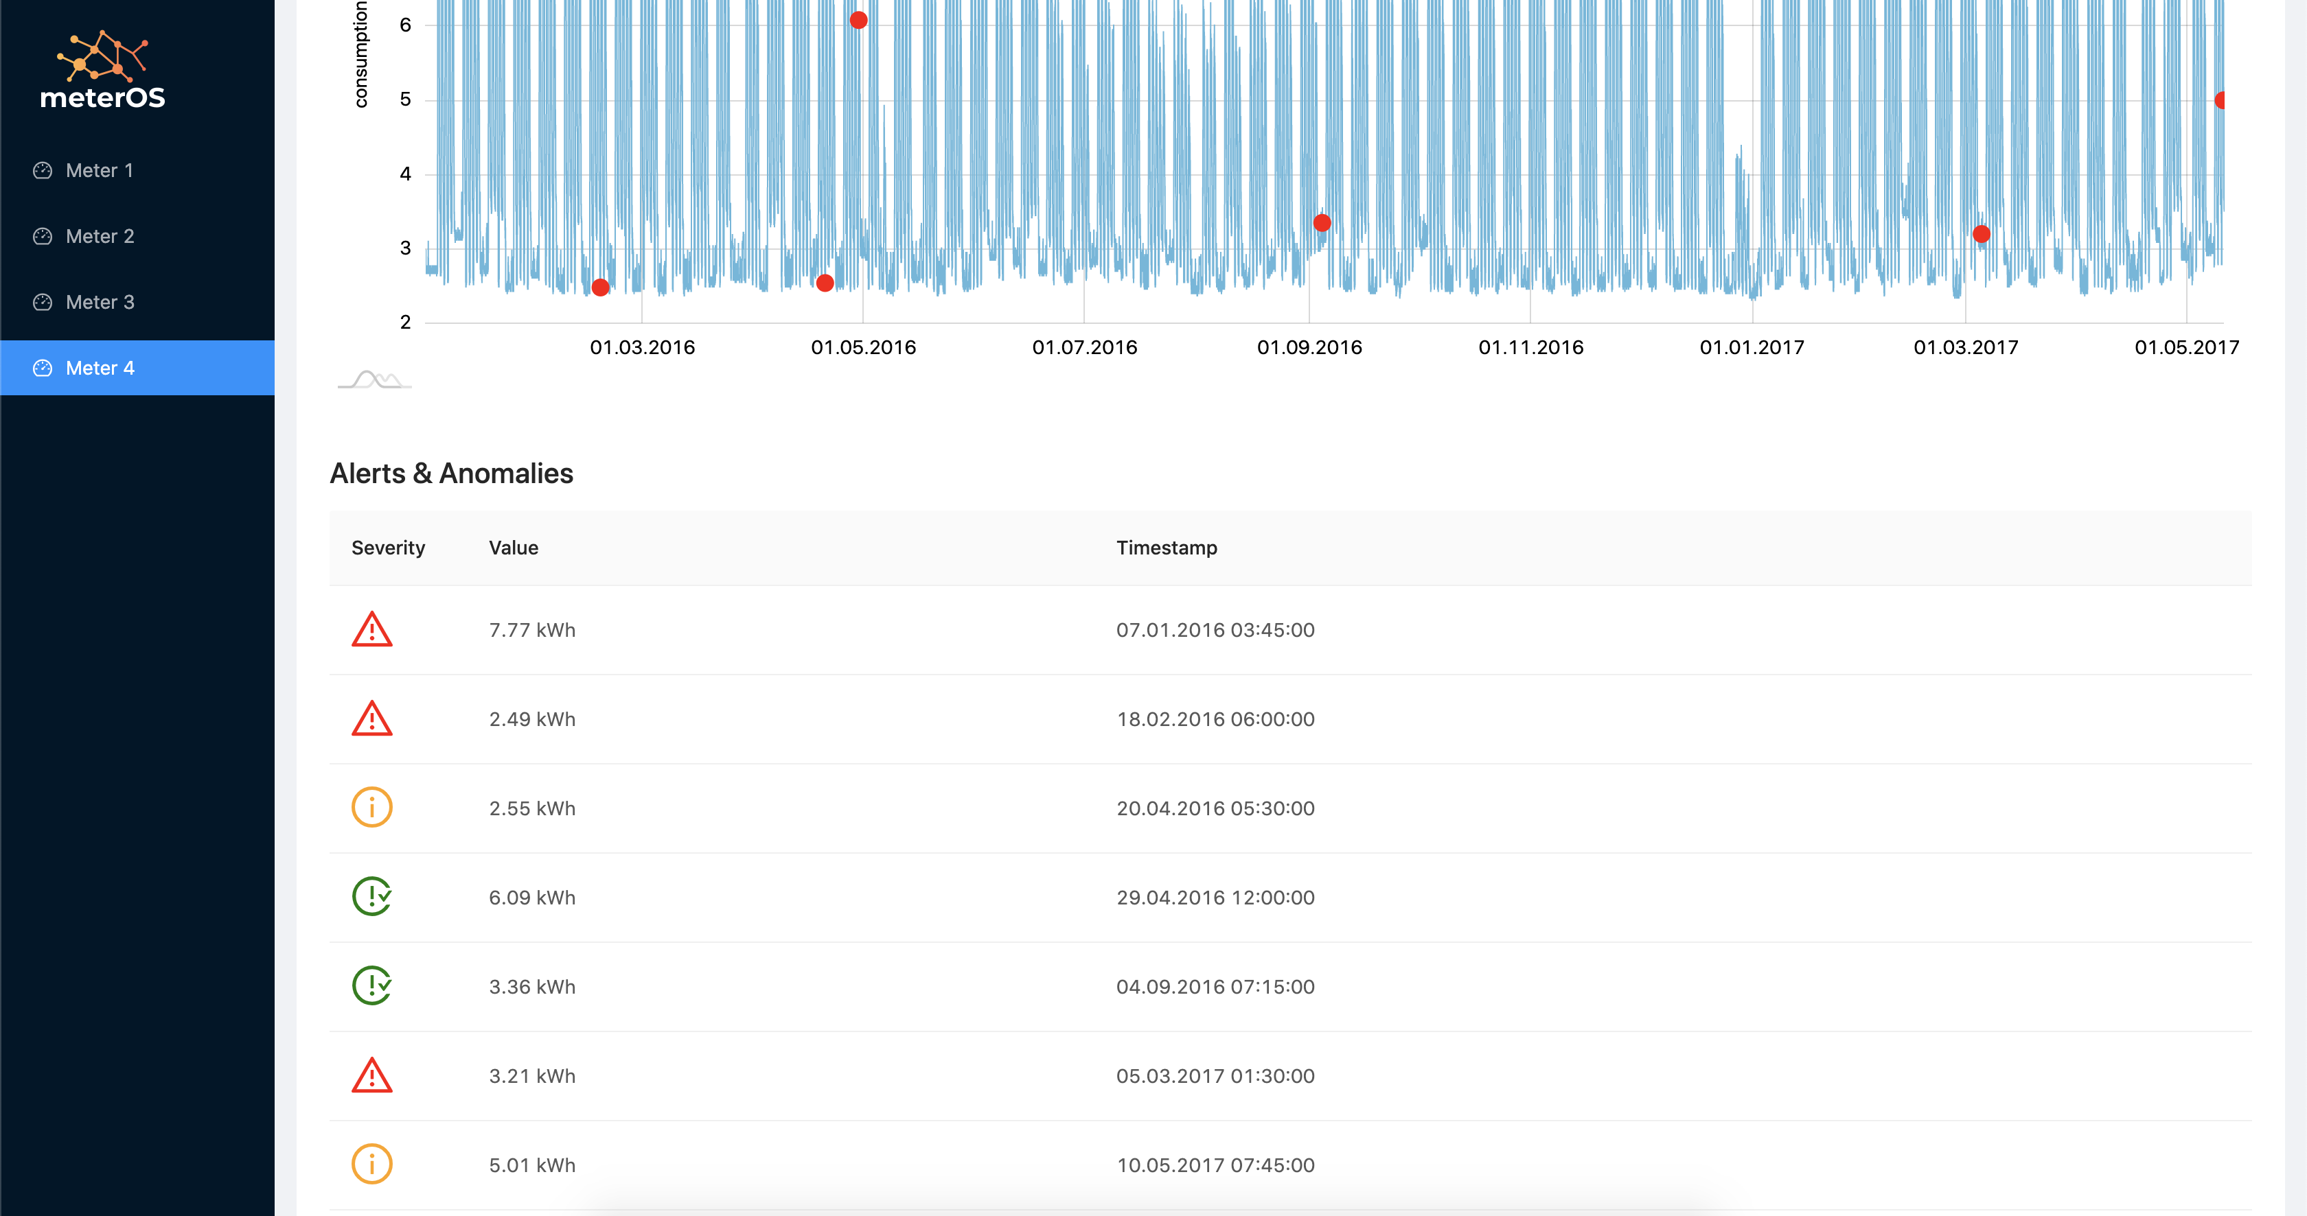
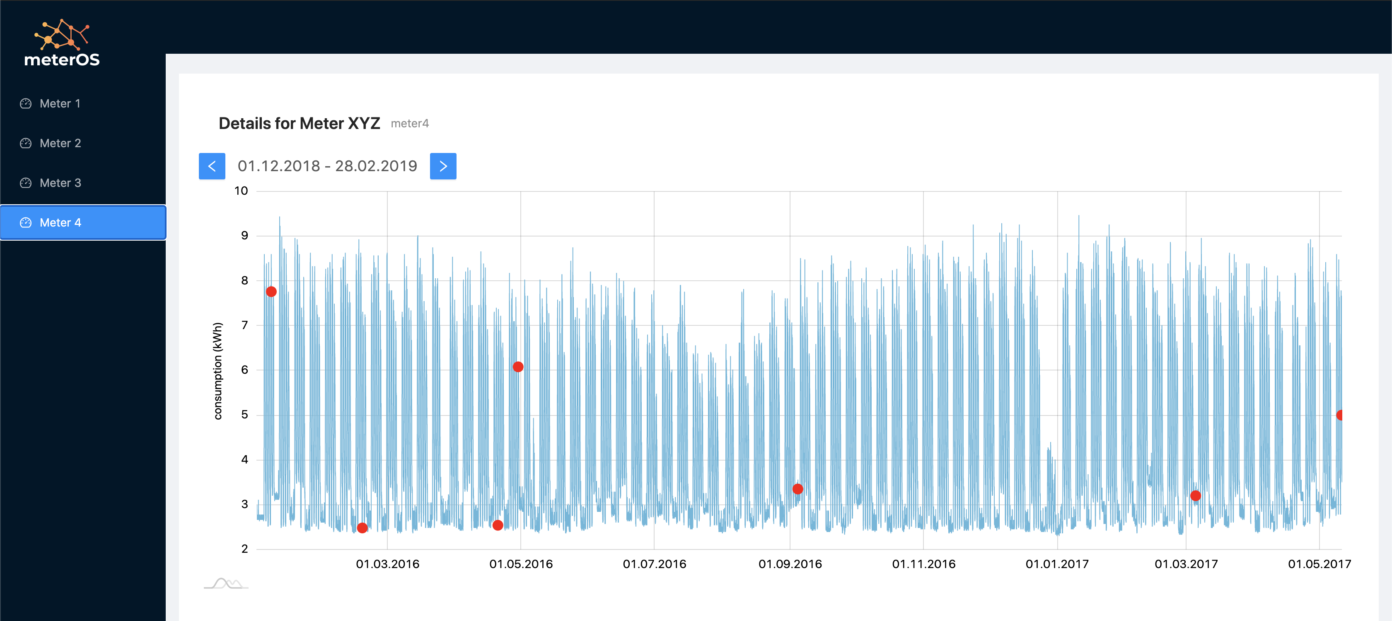
Smart Meter Data Anomaly Detection – meterOS Platform

Slide 7
Smart Meter Data Anomaly Detection – Potential Customers
Distribution System Operators (DSOs)
Provide analytics services as “smart layer” for smart meter roll-out
White labelling
Customer binding in fully-opened market
Smart Meter Manufacturers
Smart data analytics solution as ”add-on” to smart meter (sold to DSO)
White labelling
Extension of value chain

Slide 8
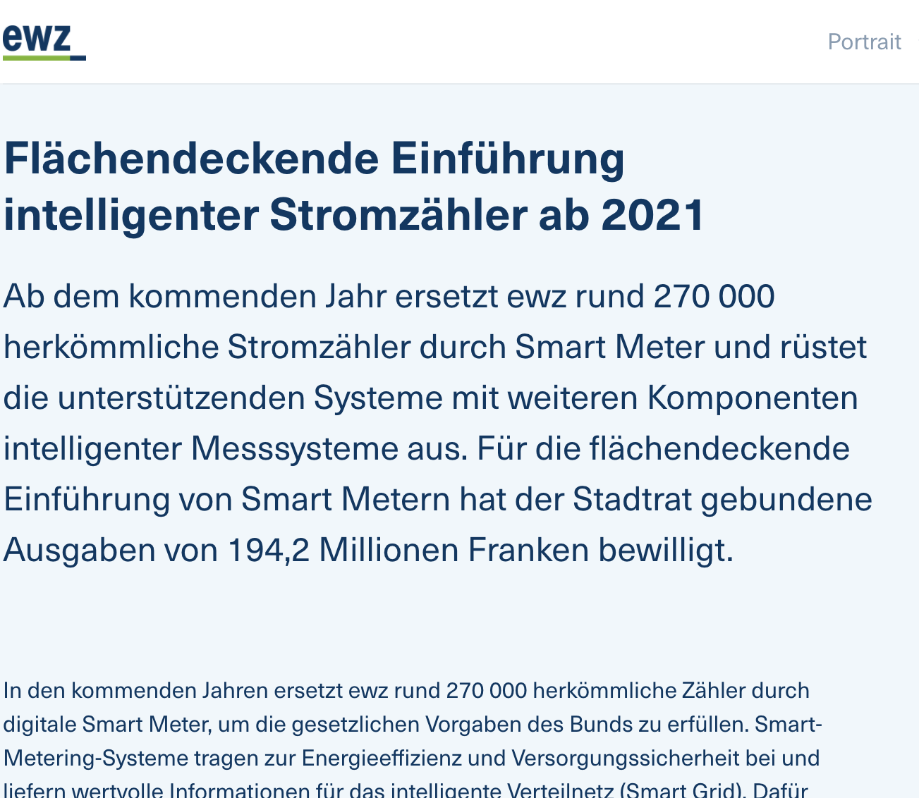
Smart Meter Data Anomaly Detection – Business Model
CAPEX ewz: 720 CHF/smart meter
meterOS: 10% savings – 150 CHF/meter/year (*)
End consumer fee: 100 CHF/meter/year for smart analytics (net savings: 50 CHF/meter/year)
DSO / meterOS: 90/10% revenue split
ewz: revenue 90 CHF/meter/year → ROI of 8 years on smart meter CAPEX invest
meterOS: revenue 10 CHF/meter/year → 2.7 Mio. CHF in total for ewz
* based on: 3000 GWh/year overall electricity consumption of City of ZH, 270’000 meters, 10’000kWh/smart meter, avg. electricity tariff: 15 Rp./kWh

Slide 9
THANK YOU!

